Slide 1
5
Wireless Technology

Slide 2
Wireless Technologies
Wireless Computer Networks and Internet Access
Pervasive Computing

Slide 3
Wireless Technologies
Wireless: without wires.
Mobile: something that changes its location over time.
Wireless technologies include both
Wireless devices, such as smartphones
Wireless transmission media, such as microwave, satellite, and radio.
Individuals are finding wireless devices convenient and productive to use, for several reasons.
First, people can make productive use of time that was formerly wasted—for example, while travelling to work on public transportation.
Second, because people can take these devices with them, their work locations are becoming much more flexible.
Third, wireless technology enables them to schedule their working time around personal and professional obligations.
Notes:
Wireless: without wires.
Mobile: something that changes its location over time.
Mobile Computing: a real-time, wireless connection between a mobile device and other computing environments, such as the Internet or an intranet.
Mobile Commerce (or M-Commerce): e-commerce (EC) transactions conducted with a mobile device.
Pervasive Computing (or Ubiquitous Computing): virtually every object has processing power with either wireless or wired connections to a global network.
Dematerialization: a phenomenon that occurs when the functions of many physical devices are included in one other physical device. Consider that your smartphone includes the functions of digital cameras for images and video, radios, televisions, Internet access via Web browsers, recording studios, editing suites, movie theaters, GPS navigators, word processors, spreadsheets, stereos, flashlights, board games, card games, video games, an entire range of medical devices, maps, atlases, encyclopedias, dictionaries, translators, textbooks, watches, alarm clocks, books, calculators, address books, credit card swipers, magnifying glasses, money and credit cards, car keys, hotel keys, cellular telephony, Wi-Fi, e-mail access, text messaging, a full QWERTY keyboard, and many, many others.

Slide 4
Wireless Technologies
Mobile Computing: a real-time, wireless connection between a mobile device and other computing environments, such as the Internet or an intranet.
Mobile Commerce (or M-Commerce): e-commerce (EC) transactions conducted with a mobile device.
Pervasive Computing (or Ubiquitous Computing): virtually every object has processing power with either wireless or wired connections to a global network.
Notes:
Wireless: without wires.
Mobile: something that changes its location over time.
Mobile Computing: a real-time, wireless connection between a mobile device and other computing environments, such as the Internet or an intranet.
Mobile Commerce (or M-Commerce): e-commerce (EC) transactions conducted with a mobile device.
Pervasive Computing (or Ubiquitous Computing): virtually every object has processing power with either wireless or wired connections to a global network.
Dematerialization: a phenomenon that occurs when the functions of many physical devices are included in one other physical device. Consider that your smartphone includes the functions of digital cameras for images and video, radios, televisions, Internet access via Web browsers, recording studios, editing suites, movie theaters, GPS navigators, word processors, spreadsheets, stereos, flashlights, board games, card games, video games, an entire range of medical devices, maps, atlases, encyclopedias, dictionaries, translators, textbooks, watches, alarm clocks, books, calculators, address books, credit card swipers, magnifying glasses, money and credit cards, car keys, hotel keys, cellular telephony, Wi-Fi, e-mail access, text messaging, a full QWERTY keyboard, and many, many others.

Slide 5
Wireless Technologies
Dematerialization:
A phenomenon that occurs when the functions of many physical devices are included in one other physical device.
Consider that your smartphone includes the functions of digital cameras for images and video, radios, televisions, Internet access via Web browsers, recording studios, editing suites, movie theaters, GPS navigators, word processors, spreadsheets, stereos, flashlights, board games, card games, video games, an entire range of medical devices, maps, atlases, encyclopedias, dictionaries, translators, textbooks, watches, alarm clocks, books, calculators, address books, credit card swipers, magnifying glasses, money and credit cards, car keys, hotel keys, cellular telephony, Wi-Fi, e-mail access, text messaging, a full QWERTY keyboard, and many, many others.
Notes:
Wireless: without wires.
Mobile: something that changes its location over time.
Mobile Computing: a real-time, wireless connection between a mobile device and other computing environments, such as the Internet or an intranet.
Mobile Commerce (or M-Commerce): e-commerce (EC) transactions conducted with a mobile device.
Pervasive Computing (or Ubiquitous Computing): virtually every object has processing power with either wireless or wired connections to a global network.
Dematerialization: a phenomenon that occurs when the functions of many physical devices are included in one other physical device. Consider that your smartphone includes the functions of digital cameras for images and video, radios, televisions, Internet access via Web browsers, recording studios, editing suites, movie theaters, GPS navigators, word processors, spreadsheets, stereos, flashlights, board games, card games, video games, an entire range of medical devices, maps, atlases, encyclopedias, dictionaries, translators, textbooks, watches, alarm clocks, books, calculators, address books, credit card swipers, magnifying glasses, money and credit cards, car keys, hotel keys, cellular telephony, Wi-Fi, e-mail access, text messaging, a full QWERTY keyboard, and many, many others.

Slide 6
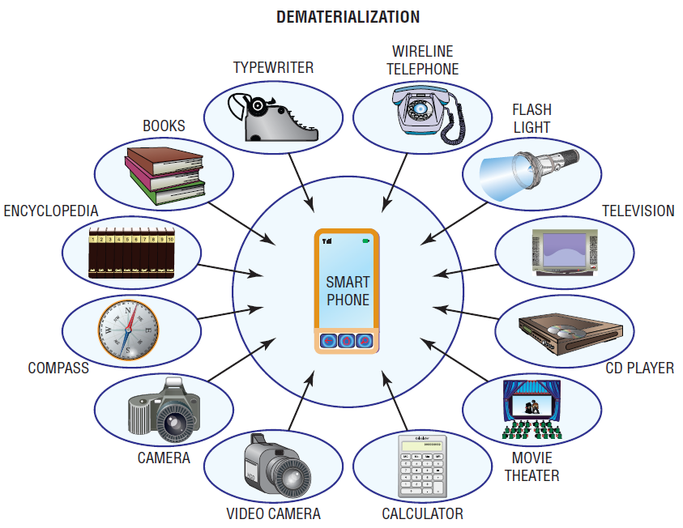
Dematerialization with Smartphones

Slide 7
Wireless Devices
Wireless Devices Provide Three Major Advantages:
Small enough to easily carry or wear
Sufficient computing power to perform productive tasks.
Can communicate wirelessly with the Internet and other devices.
Notes:
Wireless Devices Provide Three Major Advantages:
1. Small enough to easily carry or wear
2. Sufficient computing power to perform productive tasks.
3. Can communicate wirelessly with the Internet and other devices.
Wireless: without wires.
Mobile: something that changes its location over time.
Mobile Computing: a real-time, wireless connection between a mobile device and other computing environments, such as the Internet or an intranet.
Mobile Commerce (or M-Commerce): e-commerce (EC) transactions conducted with a mobile device.
Pervasive Computing (or Ubiquitous Computing): virtually every object has processing power with either wireless or wired connections to a global network.
Dematerialization: a phenomenon that occurs when the functions of many physical devices are included in one other physical device. Consider that your smartphone includes the functions of digital cameras for images and video, radios, televisions, Internet access via Web browsers, recording studios, editing suites, movie theaters, GPS navigators, word processors, spreadsheets, stereos, flashlights, board games, card games, video games, an entire range of medical devices, maps, atlases, encyclopedias, dictionaries, translators, textbooks, watches, alarm clocks, books, calculators, address books, credit card swipers, magnifying glasses, money and credit cards, car keys, hotel keys, cellular telephony, Wi-Fi, e-mail access, text messaging, a full QWERTY keyboard, and many, many others.

Slide 8
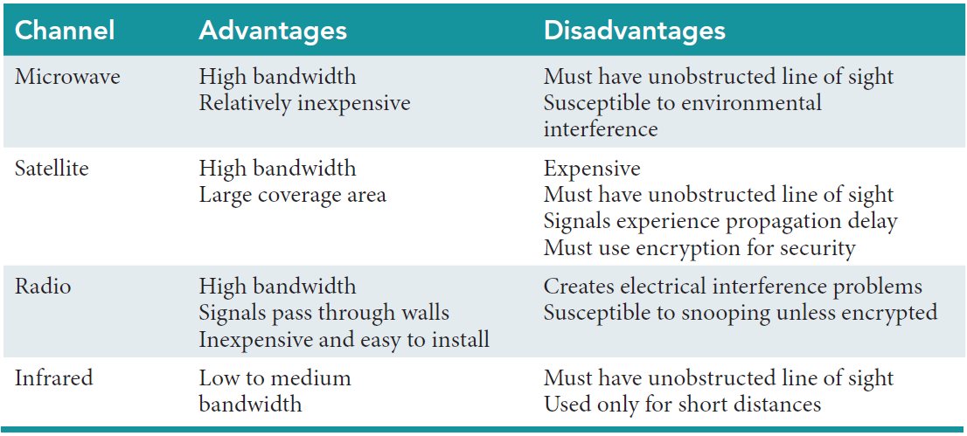
Advantages & Disadvantages of Wireless Media

Slide 9
Wireless Transmission Media: Microwave
Microwave transmission systems transmit data via electromagnetic waves.
Used for high-volume, long-distance, line-of-sight communication.
Line-of-sight means that the transmitter and receiver are in view of each other.
Advantages of Microware
High bandwidth
Relatively inexpensive
Disadvantages of Microwave
Must have unobstructed line of sight (Earth's surface is curved rather than flat. Hence microwave towers usually cannot be spaced more than 30 miles apart)
Susceptible to environmental interference during severe weather such as heavy rain and snowstorms.

Slide 10
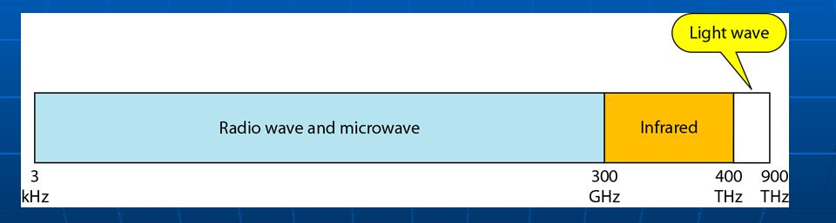

Slide 11
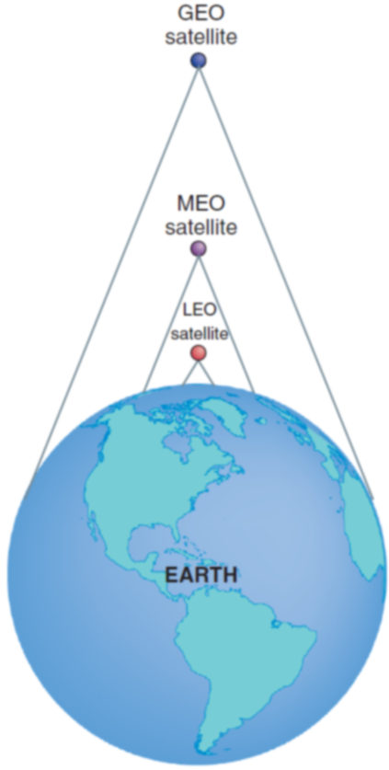
Wireless Transmission Media: Satellite
Satellite transmission systems make use of communication satellites.
There are three types of satellites circling Earth:
Geostationary (GEO)
Medium-earth-orbit (MEO)
Low-earth-orbit (LEO).
Each type has a different orbit.
GEO is farthest from Earth and the LEO the closest

Slide 12
Wireless Transmission Media: Satellite
Advantages of Satellite
High bandwidth
Large coverage area
Disadvantages of Satellite
Expensive
Must have unobstructed line of sight
Signals experience propagation delay
Must use encryption for security

Slide 13
Wireless Transmission Media: Satellite
Footprint:
The area of Earth’s surface reached by a satellite’s transmission overcomes the limitations of microwave data relay stations.
The higher a satellite orbits, the larger its footprint.
Medium-earth-orbit satellites have a smaller footprint than geostationary satellites.
Low-earth-orbit satellites have the smallest footprint of all.
Though satellites are line-of-sight like microwave, they are high enough for broadcast transmission, thus overcoming the limitations
Notes:
Footprint: the area of Earth’s surface reached by a satellite’s transmission overcomes the limitations of microwave data relay stations. The higher a satellite orbits, the larger its footprint.
Propagation Delay: One major limitation of GEO satellites is that their transmissions take a quarter of a second to send and return from the earth's surface.
Footprint: the area of Earth’s surface reached by a satellite’s transmission overcomes the limitations of microwave data relay stations. The higher a satellite orbits, the larger its footprint.
Propagation Delay: One major limitation of GEO satellites is that their transmissions take a quarter of a second to send and return from the earth's surface.
Global Positioning System: a wireless system that utilizes satellites to enable users to determine their position anywhere on Earth. GPS is supported by 24 MEO satellites that are shared worldwide.
Satellite Radio (or digital radio): offers uninterrupted, near CD-quality transmission that is beamed to your radio, either at home or in your car, from both GEO (XM Radio) and MEO (Sirius) satellites in space.

Slide 14
Wireless Transmission Media: Satellite
Propagation Delay: One major limitation of GEO satellites is that their transmissions take a quarter of a second to send and return from the earth's surface.
Global Positioning System: a wireless system that utilizes satellites to enable users to determine their position anywhere on Earth. GPS is supported by 24 MEO satellites that are shared worldwide.
Satellite Radio (or digital radio): offers uninterrupted, near CD-quality transmission that is beamed to your radio, either at home or in your car, from both GEO (XM Radio) and MEO (Sirius) satellites in space.
Notes:
Footprint: the area of Earth’s surface reached by a satellite’s transmission overcomes the limitations of microwave data relay stations. The higher a satellite orbits, the larger its footprint.
Propagation Delay: One major limitation of GEO satellites is that their transmissions take a quarter of a second to send and return from the earth's surface.
Footprint: the area of Earth’s surface reached by a satellite’s transmission overcomes the limitations of microwave data relay stations. The higher a satellite orbits, the larger its footprint.
Propagation Delay: One major limitation of GEO satellites is that their transmissions take a quarter of a second to send and return from the earth's surface.
Global Positioning System: a wireless system that utilizes satellites to enable users to determine their position anywhere on Earth. GPS is supported by 24 MEO satellites that are shared worldwide.
Satellite Radio (or digital radio): offers uninterrupted, near CD-quality transmission that is beamed to your radio, either at home or in your car, from both GEO (XM Radio) and MEO (Sirius) satellites in space.

Slide 15
Satellites: Geostationary-Earth-Orbit (GEO)
22,300 miles above equator of the earth
Satellites stationary relative to point on Earth.
Their orbital period matches the 24-hour rotational period of Earth.
For this reason, receivers on Earth do not have to track GEO satellites.
GEO satellites are excellent for sending television programs to cable operators and for broadcasting directly to homes.
Limitation:
GEO satellites is that their transmissions take a quarter of a second to send and return(propagation delay) makes two-way telephone conversations difficult.
GEO satellites are large and expensive.
They require substantial amounts of power to launch.
Notes:
Footprint: the area of Earth’s surface reached by a satellite’s transmission overcomes the limitations of microwave data relay stations. The higher a satellite orbits, the larger its footprint.
Propagation Delay: One major limitation of GEO satellites is that their transmissions take a quarter of a second to send and return from the earth's surface.
Footprint: the area of Earth’s surface reached by a satellite’s transmission overcomes the limitations of microwave data relay stations. The higher a satellite orbits, the larger its footprint.
Propagation Delay: One major limitation of GEO satellites is that their transmissions take a quarter of a second to send and return from the earth's surface.
Global Positioning System: a wireless system that utilizes satellites to enable users to determine their position anywhere on Earth. GPS is supported by 24 MEO satellites that are shared worldwide.
Satellite Radio (or digital radio): offers uninterrupted, near CD-quality transmission that is beamed to your radio, either at home or in your car, from both GEO (XM Radio) and MEO (Sirius) satellites in space.

Slide 16
Satellites: Medium-Earth-Orbit (MEO)
6,434 miles above earth
Satellites moves relative to a point on Earth
Negligible transmission delay
Moderate orbital life (6-12 years)
Moderate number needed for global coverage
Used for Global Positioning Systems
Less Expensive to Build and Launch
Notes:
Footprint: the area of Earth’s surface reached by a satellite’s transmission overcomes the limitations of microwave data relay stations. The higher a satellite orbits, the larger its footprint.
Propagation Delay: One major limitation of GEO satellites is that their transmissions take a quarter of a second to send and return from the earth's surface.
Global Positioning System: a wireless system that utilizes satellites to enable users to determine their position anywhere on Earth. GPS is supported by 24 MEO satellites that are shared worldwide.
Satellite Radio (or digital radio): offers uninterrupted, near CD-quality transmission that is beamed to your radio, either at home or in your car, from both GEO (XM Radio) and MEO (Sirius) satellites in space.

Slide 17
Satellites: Medium-Earth-Orbit (MEO)
Located about 6,000 miles above Earth’s surface.
MEO orbits require more satellites to cover Earth than GEO
orbits because MEO footprints are smaller.
Used in GPS.
MEO satellites have two advantages over GEO satellites:
They are less expensive
They do not have an appreciable propagation delay.
However, because MEO satellites move with respect to a point on Earth’s surface, receivers must track these satellites

Slide 18
Satellites: Low-Earth-Orbit (LEO)
located 400 to 700 miles above Earth’s surface.
LEO satellites are much closer to Earth, they have little propagation delay.
LEO satellites also move with respect to a point on Earth’s surface and therefore must be tracked by receivers.
As compared to MEO satellites ,Tracking LEO satellites is more difficult because LEO satellites move much more quickly.
Advantages:
LEO satellites can pick up signals from weak transmitters.
Hence it possible for satellite telephones to operate via LEO satellites, because they can operate with less power using smaller batteries.
LEO satellites is that they consume less power.
Cost is less to launch.

Slide 19
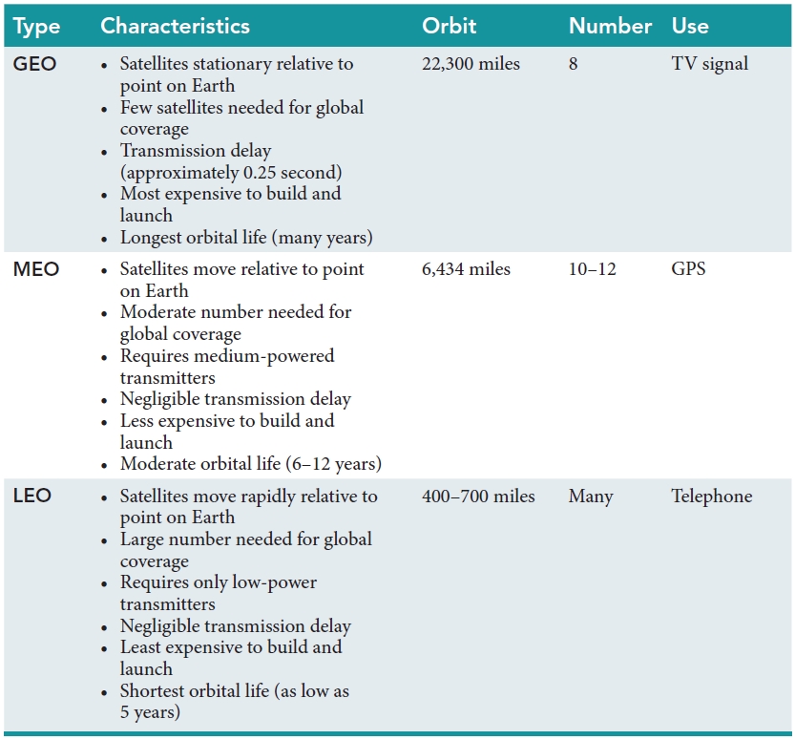
Three Basic Types of Telecommunications Satellites

Slide 20
Satellites: Low-Earth-Orbit (LEO)
400-700 miles above earth
Move rapidly in relation to a point on Earth
Negligible transmission delay
Shortest orbital life (low as 5 years)
Large Number Needed for Global Coverage
Least Expensive to Build and Launch
Notes:
Footprint: the area of Earth’s surface reached by a satellite’s transmission overcomes the limitations of microwave data relay stations. The higher a satellite orbits, the larger its footprint.
Propagation Delay: One major limitation of GEO satellites is that their transmissions take a quarter of a second to send and return from the earth's surface.

Slide 21
Satellites
Two major satellite applications:
Global positioning systems
Internet transmission via satellites.
Notes:
Footprint: the area of Earth’s surface reached by a satellite’s transmission overcomes the limitations of microwave data relay stations. The higher a satellite orbits, the larger its footprint.
Propagation Delay: One major limitation of GEO satellites is that their transmissions take a quarter of a second to send and return from the earth's surface.
Internet Over Satellite (IoS): in remote parts of the world it is the only option available for Internet connections because installing cables is either too expensive or physically impossible.

Slide 22
Satellites: Global positioning systems
GPS is a wireless system that utilizes satellites to enable users to determine their position anywhere on Earth.
GPS is supported by 24 MEO satellites that are shared worldwide.
The exact position of each satellite is always known because the satellite continuously broadcasts its position along with a time
signal.
By using the known speed of the signals and the distance from three satellites (for two dimensional location) or four satellites (for three-dimensional location), it is possible to find the location of any receiving station or user within a range of 10 feet.
GPS software can also convert the user’s latitude and longitude to an electronic map.
GPS in automobiles tell directions.
Commercial use of GPS for activities such as navigating, mapping, and surveying, particularly in remote areas
Notes:
Footprint: the area of Earth’s surface reached by a satellite’s transmission overcomes the limitations of microwave data relay stations. The higher a satellite orbits, the larger its footprint.
Propagation Delay: One major limitation of GEO satellites is that their transmissions take a quarter of a second to send and return from the earth's surface.
Internet Over Satellite (IoS): in remote parts of the world it is the only option available for Internet connections because installing cables is either too expensive or physically impossible.

Slide 23
Internet transmission via satellites
In many regions of the world, Internet over Satellite (IoS) is the only option available for Internet connections because installing cables is either too expensive or physically impossible.
IoS enables users to access the Internet via GEO satellites from a dish mounted on the side of their homes.
Although IoS makes the Internet available to
many people who otherwise could not access it, it has its drawbacks.
Not only do GEO satellite transmissions involve a propagation delay, but they also can be disrupted by environmental influences such as thunderstorms.

Slide 24
’S ABOUT BUSINESS 10.1
Skybox Imaging Provides Commercial Images from Earth’s Orbit
Describe other applications of Skybox Imaging (not mentioned in the case).
Why might the U.S. government object to Skybox Imaging’s business? Provide specific examples in your answer.
Might other nations object to Skybox Imaging’s business? If so, which ones, and why?

Slide 25
Wireless Transmission Media: Radio
Radio transmission uses radio-wave frequencies to send data directly between transmitters and receivers.
Advantages:
Radio waves travel easily through walls.
Radio devices are fairly inexpensive and easy to install.
Radio waves can transmit data at high speeds.
Drawbacks:
Radio media can create electrical interference problems.
Radio transmissions are susceptible to snooping by anyone who has similar equipment that operates on the same frequency.
When you travel too far away from the source station, the signal breaks up and fades into static.
Most radio signals can travel only 30 to 40 miles from their source.
Notes:
Radio: uses radio-wave frequencies to send data directly between transmitters and receivers.

Slide 26
Wireless Transmission Media: Radio
Satellite radio (or digital radio) offers uninterrupted, near CD-quality transmission that is beamed to your radio, either at home or in your car, from space.
In addition, satellite radio offers a broad spectrum of stations, including many types of music, news, and talk.
XM Satellite Radio and Sirius Satellite Radio were competitors that launched satellite radio services.
XM broadcast its signals from GEO satellites, while Sirius used MEO satellites.
In July 2008, the two companies merged to form Sirius XM (www.siriusxm.com).
Listeners subscribe to the service for a monthly fee.
Notes:
Radio: uses radio-wave frequencies to send data directly between transmitters and receivers.

Slide 27
Wireless Transmission Media: Radio
Satellite radio (or digital radio) offers uninterrupted, near CD-quality transmission that is beamed to your radio, either at home or in your car, from space.
In addition, satellite radio offers a broad spectrum of stations, including many types of music, news, and talk.
Listeners subscribe to the service for a monthly fee.
Notes:
Radio: uses radio-wave frequencies to send data directly between transmitters and receivers.

Slide 28
Wireless Transmission Media: Infrared
Infrared light is red light that is not commonly visible to human eyes.
Applications of infrared light:
Remote control units for televisions, VCRs, and DVD and CD players.
Infrared transceivers are used for short-distance connections between computers and peripheral equipment and local area networks.
A transceiver is a device that can both transmit and receive signals.
Advantages of Infrared
Low to medium bandwidth
Disadvantages of Infrared
Must have unobstructed line of sight
Used only for short distances

Slide 29
Wireless Computer Networks and Internet Access
Short-Range Wireless Networks
Medium-Range Wireless Networks
Wide-Area Wireless Networks
Notes:
Short-Range Wireless Networks: have a range of 100 feet or less (e.g., Bluetooth, ultra-wideband (UWB), and near-field communications (NFC)).
Medium-Range Wireless Networks: the familiar wireless local area networks (WLANs) and the most common type of Medium-Range network is wireless fidelity (Wi-Fi).
Wide-Area Wireless Networks: networks that connect users to the Internet over a geographically dispersed territory, they typically operate over the licensed spectrum (government regulation).that is, they use portions of the wireless spectrum that are regulated by the government.

Slide 30
Wireless Computer Networks and Internet Access
Short-Range Wireless Networks: have a range of 100 feet or less (e.g., Bluetooth, ultra-wideband (UWB), and near-field communications (NFC)).
Medium-Range Wireless Networks: the familiar wireless local area networks (WLANs) and the most common type of Medium-Range network is wireless fidelity (Wi-Fi).
Wide-Area Wireless Networks: networks that connect users to the Internet over a geographically dispersed territory, they typically operate over the licensed spectrum (government regulation).that is, they use portions of the wireless spectrum that are regulated by the government.
Notes:
Short-Range Wireless Networks: have a range of 100 feet or less (e.g., Bluetooth, ultra-wideband (UWB), and near-field communications (NFC)).
Medium-Range Wireless Networks: the familiar wireless local area networks (WLANs) and the most common type of Medium-Range network is wireless fidelity (Wi-Fi).
Wide-Area Wireless Networks: networks that connect users to the Internet over a geographically dispersed territory, they typically operate over the licensed spectrum (government regulation).that is, they use portions of the wireless spectrum that are regulated by the government.

Slide 31
Short-Range Wireless Networks
Bluetooth
Bluetooth 1.0
Bluetooth 4.0
Personal Area Network
Ultra-Wideband
Near-Field Communications
Notes:
Short-Range Wireless Networks: have a range of 100 feet or less (e.g., Bluetooth, ultra-wideband (UWB), and near-field communications (NFC)).
Bluetooth: an industry specification used to create small personal area networks.
Bluetooth 1.0: can link up to eight devices within a 10-meter area (about 30 feet) with a bandwidth of 700 kilobits per second (Kbps) using low-power, radio-based communication.
Bluetooth 4.0: can transmit up to approximately 25 megabits per second (Mbps) up to 100 meters (roughly 300 feet).
Personal Area Network: a computer network used for communication among computer devices (e.g., telephones, personal digital assistants, and smartphones) located close to one person.
Ultra-Wideband: a high-bandwidth wireless technology with transmission speeds in excess of 100 Mbps which makes UWB a good choice for applications such as streaming multimedia from a personal computer to a television.
Near-Field Communications: has the smallest range of any short-range wireless networks, and is designed to be embedded in mobile devices such as cell phones and credit cards.

Slide 32
Short-Range Wireless Networks
A range of 100 feet or less (e.g., Bluetooth, ultra-wideband (UWB), and near-field communications (NFC)).
Bluetooth: an industry specification used to create small personal area networks.
Bluetooth 1.0: can link up to eight devices within a 10-meter area (about 30 feet) with a bandwidth of 700 kilobits per second (Kbps) using low-power, radio-based communication.
Bluetooth 4.0: can transmit up to approximately 25 megabits per second (Mbps) up to 100 meters (roughly 300 feet).
Personal Area Network: a computer network used for communication among computer devices (e.g., telephones, personal digital assistants, and smartphones) located close to one person.
Notes:
Short-Range Wireless Networks: have a range of 100 feet or less (e.g., Bluetooth, ultra-wideband (UWB), and near-field communications (NFC)).
Bluetooth: an industry specification used to create small personal area networks.
Bluetooth 1.0: can link up to eight devices within a 10-meter area (about 30 feet) with a bandwidth of 700 kilobits per second (Kbps) using low-power, radio-based communication.
Bluetooth 4.0: can transmit up to approximately 25 megabits per second (Mbps) up to 100 meters (roughly 300 feet).
Personal Area Network: a computer network used for communication among computer devices (e.g., telephones, personal digital assistants, and smartphones) located close to one person.
Ultra-Wideband: a high-bandwidth wireless technology with transmission speeds in excess of 100 Mbps which makes UWB a good choice for applications such as streaming multimedia from a personal computer to a television.
Near-Field Communications: has the smallest range of any short-range wireless networks, and is designed to be embedded in mobile devices such as cell phones and credit cards.

Slide 33
Short-Range Wireless Networks
Ultra-Wideband: a high-bandwidth wireless technology with transmission speeds in excess of 100 Mbps which makes UWB a good choice for applications such as streaming multimedia from a personal computer to a television.
Near-Field Communications: has the smallest range of any short-range wireless networks, and is designed to be embedded in mobile devices such as cell phones and credit cards.
Notes:
Short-Range Wireless Networks: have a range of 100 feet or less (e.g., Bluetooth, ultra-wideband (UWB), and near-field communications (NFC)).
Bluetooth: an industry specification used to create small personal area networks.
Bluetooth 1.0: can link up to eight devices within a 10-meter area (about 30 feet) with a bandwidth of 700 kilobits per second (Kbps) using low-power, radio-based communication.
Bluetooth 4.0: can transmit up to approximately 25 megabits per second (Mbps) up to 100 meters (roughly 300 feet).
Personal Area Network: a computer network used for communication among computer devices (e.g., telephones, personal digital assistants, and smartphones) located close to one person.
Ultra-Wideband: a high-bandwidth wireless technology with transmission speeds in excess of 100 Mbps which makes UWB a good choice for applications such as streaming multimedia from a personal computer to a television.
Near-Field Communications: has the smallest range of any short-range wireless networks, and is designed to be embedded in mobile devices such as cell phones and credit cards.

Slide 34
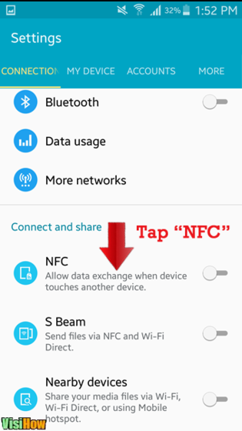

Slide 35
Medium-Range Wireless Networks
Wireless Fidelity (Wi-Fi)
Wireless Mesh Networks
Notes:
Medium-Range Wireless Networks: the familiar wireless local area networks (WLANs) and the most common type of Medium-Range network is wireless fidelity (Wi-Fi).
Wireless Fidelity (Wi-Fi): a medium-range WLAN.
Wireless Mesh Networks: networks using multiple Wi-Fi access points to create a wide area network that can be quite large and are essentially a series of interconnected local area networks.

Slide 36
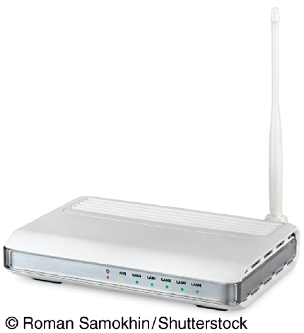
Wireless Fidelity (Wi-Fi)
Wireless Access Point
Hotspot
IEEE Wi-Fi Standards
Major Benefits of Wi-Fi
Wi-Fi Direct
MiFi
Super Wi-Fi
Wireless Mesh Networks
Notes:
Wireless Fidelity (Wi-Fi): a medium-range WLAN.
Wireless Access Point: a Wi-Fi medium range WLAN and a typical configuration includes a tranmitter with an antenna.
Hotspot: a wireless access point that provides service to a number of users within a small geographical perimeter (up to approximately 300 feet).
Wi-Fi Direct: enables peer-to-peer communications, so devices can connect directly allowing users to transfer content among devices without having to rely on a wireless antenna. It can connect pairs or groups of devices at Wi-Fi speeds of up to 250 Mbps and at distances of up to 800 feet.
MiFi: a small, portable wireless device that provides users with a permanent Wi-Fi hotspot wherever they go with a range of about 10 meters (roughly 30 feet).
Super Wi-Fi: a wireless network proposal that creates long-distance wireless Internet connections which uses the lower-frequency “white spaces” between broadcast TV channels which enable the signal to travel further and penetrate walls better than normal Wi-Fi frequencies.
Wireless Mesh Networks: networks using multiple Wi-Fi access points to create a wide area network that can be quite large and are essentially a series of interconnected local area networks.

Slide 37
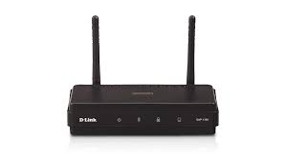
Wireless Fidelity (Wi-Fi)
Wireless Fidelity (Wi-Fi): a medium-range WLAN.
Wireless Access Point: a Wi-Fi medium range WLAN and a typical configuration includes a transmitter with an antenna.
Notes:
Wireless Fidelity (Wi-Fi): a medium-range WLAN.
Wireless Access Point: a Wi-Fi medium range WLAN and a typical configuration includes a tranmitter with an antenna.
Hotspot: a wireless access point that provides service to a number of users within a small geographical perimeter (up to approximately 300 feet).
Wi-Fi Direct: enables peer-to-peer communications, so devices can connect directly allowing users to transfer content among devices without having to rely on a wireless antenna. It can connect pairs or groups of devices at Wi-Fi speeds of up to 250 Mbps and at distances of up to 800 feet.
MiFi: a small, portable wireless device that provides users with a permanent Wi-Fi hotspot wherever they go with a range of about 10 meters (roughly 30 feet).
Super Wi-Fi: a wireless network proposal that creates long-distance wireless Internet connections which uses the lower-frequency “white spaces” between broadcast TV channels which enable the signal to travel further and penetrate walls better than normal Wi-Fi frequencies.
Wireless Mesh Networks: networks using multiple Wi-Fi access points to create a wide area network that can be quite large and are essentially a series of interconnected local area networks.

Slide 38
Wireless Fidelity (Wi-Fi)
Hotspot: a wireless access point that provides service to a number of users within a small geographical perimeter (up to approximately 300 feet).
Wi-Fi Direct: enables peer-to-peer communications, so devices can connect directly allowing users to transfer content among devices without having to rely on a wireless antenna. It can connect pairs or groups of devices at Wi-Fi speeds of up to 250 Mbps and at distances of up to 800 feet.
Notes:
Wireless Fidelity (Wi-Fi): a medium-range WLAN.
Wireless Access Point: a Wi-Fi medium range WLAN and a typical configuration includes a tranmitter with an antenna.
Hotspot: a wireless access point that provides service to a number of users within a small geographical perimeter (up to approximately 300 feet).
Wi-Fi Direct: enables peer-to-peer communications, so devices can connect directly allowing users to transfer content among devices without having to rely on a wireless antenna. It can connect pairs or groups of devices at Wi-Fi speeds of up to 250 Mbps and at distances of up to 800 feet.
MiFi: a small, portable wireless device that provides users with a permanent Wi-Fi hotspot wherever they go with a range of about 10 meters (roughly 30 feet).
Super Wi-Fi: a wireless network proposal that creates long-distance wireless Internet connections which uses the lower-frequency “white spaces” between broadcast TV channels which enable the signal to travel further and penetrate walls better than normal Wi-Fi frequencies.
Wireless Mesh Networks: networks using multiple Wi-Fi access points to create a wide area network that can be quite large and are essentially a series of interconnected local area networks.

Slide 39
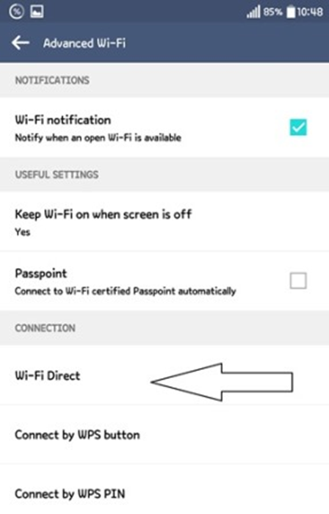

Slide 40
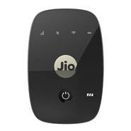
Wireless Fidelity (Wi-Fi)
MiFi: a small, portable wireless device that provides users with a permanent Wi-Fi hotspot wherever they go with a range of about 10 meters (roughly 30 feet).
Super Wi-Fi: a wireless network proposal that creates long-distance wireless Internet connections which uses the lower-frequency “white spaces” between broadcast TV channels which enable the signal to travel further and penetrate walls better than normal Wi-Fi frequencies.
Wireless Mesh Networks: networks using multiple Wi-Fi access points to create a wide area network that can be quite large and are essentially a series of interconnected local area networks.
Notes:
Wireless Fidelity (Wi-Fi): a medium-range WLAN.
Wireless Access Point: a Wi-Fi medium range WLAN and a typical configuration includes a tranmitter with an antenna.
Hotspot: a wireless access point that provides service to a number of users within a small geographical perimeter (up to approximately 300 feet).
Wi-Fi Direct: enables peer-to-peer communications, so devices can connect directly allowing users to transfer content among devices without having to rely on a wireless antenna. It can connect pairs or groups of devices at Wi-Fi speeds of up to 250 Mbps and at distances of up to 800 feet.
MiFi: a small, portable wireless device that provides users with a permanent Wi-Fi hotspot wherever they go with a range of about 10 meters (roughly 30 feet).
Super Wi-Fi: a wireless network proposal that creates long-distance wireless Internet connections which uses the lower-frequency “white spaces” between broadcast TV channels which enable the signal to travel further and penetrate walls better than normal Wi-Fi frequencies.
Wireless Mesh Networks: networks using multiple Wi-Fi access points to create a wide area network that can be quite large and are essentially a series of interconnected local area networks.

Slide 41
Wireless Fidelity (Wi-Fi)
MiFi: a small, portable wireless device that provides users with a permanent Wi-Fi hotspot wherever they go with a range of about 10 meters (roughly 30 feet).
Wireless Mesh Networks: networks using multiple Wi-Fi access points to create a wide area network that can be quite large and are essentially a series of interconnected local area networks.
Notes:
Wireless Fidelity (Wi-Fi): a medium-range WLAN.
Wireless Access Point: a Wi-Fi medium range WLAN and a typical configuration includes a tranmitter with an antenna.
Hotspot: a wireless access point that provides service to a number of users within a small geographical perimeter (up to approximately 300 feet).
Wi-Fi Direct: enables peer-to-peer communications, so devices can connect directly allowing users to transfer content among devices without having to rely on a wireless antenna. It can connect pairs or groups of devices at Wi-Fi speeds of up to 250 Mbps and at distances of up to 800 feet.
MiFi: a small, portable wireless device that provides users with a permanent Wi-Fi hotspot wherever they go with a range of about 10 meters (roughly 30 feet).
Super Wi-Fi: a wireless network proposal that creates long-distance wireless Internet connections which uses the lower-frequency “white spaces” between broadcast TV channels which enable the signal to travel further and penetrate walls better than normal Wi-Fi frequencies.
Wireless Mesh Networks: networks using multiple Wi-Fi access points to create a wide area network that can be quite large and are essentially a series of interconnected local area networks.

Slide 42
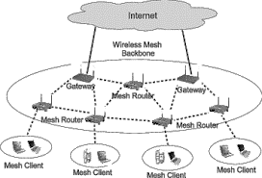
Wireless Mesh Networks

Slide 43
IEEE Wi-Fi Standards
Institute of Electrical and Electronics Engineers (IEEE) WiFI Standards
802.11a
802.11b
802.11g
802.11n
802.11ac
802.11 ad
Notes:
Institute of Electrical and Electronics Engineers (IEEE) WiFI Standards
802.11a: supports wireless bandwidth up to 54 Mbps; high cost; short range; difficulty penetrating walls.
802.11b: supports wireless bandwidth up to 11 Mbps; low cost; longer range.
802.11g: supports wireless bandwidth up to 54 Mbps; high cost; longer range.
802.11n: supports wireless bandwidth exceeding 600 Mbps; higher cost than 802.11g; longer range than 802.11g.
802.11ac: will support wireless bandwidth of 1.3 Gbps (1.3 billion bits per second); will provide the ability to fully support a “multimedia home” in which high-definition video can be streamed simultaneously to multiple devices. Essentially, you will be able to wirelessly network your TV, DVR, smartphone, and sound system for complete ondemand access through any Internet-enabled device.
802.11 ad: supports wireless bandwidth up to 7 Gbps; targeted to the “wireless office” as opposed to the “wireless home.”

Slide 44
IEEE Wi-Fi Standards
Institute of Electrical and Electronics Engineers (IEEE) WiFI Standards
802.11a: supports wireless bandwidth up to 54 Mbps; high cost; short range; difficulty penetrating walls.
802.11b: supports wireless bandwidth up to 11 Mbps; low cost; longer range.
802.11g: supports wireless bandwidth up to 54 Mbps; high cost; longer range.
802.11n: supports wireless bandwidth exceeding 600 Mbps; higher cost than 802.11g; longer range than 802.11g.
802.11ac: will support wireless bandwidth of 1.3 Gbps (1.3 billion bits per second); will provide the ability to fully support a “multimedia home” in which high-definition video can be streamed simultaneously to multiple devices. Essentially, you will be able to wirelessly network your TV, DVR, smartphone, and sound system for complete ondemand access through any Internet-enabled device.
802.11 ad: supports wireless bandwidth up to 7 Gbps; targeted to the “wireless office” as opposed to the “wireless home.”
Notes:
Institute of Electrical and Electronics Engineers (IEEE) WiFI Standards
802.11a: supports wireless bandwidth up to 54 Mbps; high cost; short range; difficulty penetrating walls.
802.11b: supports wireless bandwidth up to 11 Mbps; low cost; longer range.
802.11g: supports wireless bandwidth up to 54 Mbps; high cost; longer range.
802.11n: supports wireless bandwidth exceeding 600 Mbps; higher cost than 802.11g; longer range than 802.11g.
802.11ac: will support wireless bandwidth of 1.3 Gbps (1.3 billion bits per second); will provide the ability to fully support a “multimedia home” in which high-definition video can be streamed simultaneously to multiple devices. Essentially, you will be able to wirelessly network your TV, DVR, smartphone, and sound system for complete ondemand access through any Internet-enabled device.
802.11 ad: supports wireless bandwidth up to 7 Gbps; targeted to the “wireless office” as opposed to the “wireless home.”

Slide 45
Major Benefits of Wi-Fi
Low cost
Ability to provide simple Internet access

Slide 46
Three Factors Preventing Commercial Wi-Fi Market from Expanding:
Roaming: At this time, users cannot roam from hotspot to hotspot if the hotspots use different Wi-Fi network services. Unless the service is free, users have to log on to separate accounts.
Security: the second barrier to greater acceptance of Wi-Fi because Wi-Fi uses radio waves, it is difficult to shield from intruders.
Cost: even though Wi-Fi services are relatively inexpensive, many experts question whether commercial Wi-Fi services can survive when so many free hotspots are available to users.
Notes:
Three factors are prevent the commercial Wi-Fi market from expanding:
Roaming: At this time, users cannot roam from hotspot to hotspot if the hotspots use different Wi-Fi network services. Unless the service is free, users have to log on to separate accounts.
Security: the second barrier to greater acceptance of Wi-Fi because Wi-Fi uses radio waves, it is difficult to shield from intruders.
Cost: even though Wi-Fi services are relatively inexpensive, many experts question whether commercial Wi-Fi services can survive when so many free hotspots are available to users.

Slide 47
’S ABOUT BUSINESS 10.2
A Wi-Fi Network Provides Communications at the 2014 Winter Olympic Games
Describe why wireless communications were critical to the success of the 2014 Winter Olympic Games. Provide specific examples to support your answer.
What other potential problems did Avaya have to consider that were not mentioned in this case? Provide specific examples to support your answer.

Slide 48
Wide-Area Wireless Networks
Wide-Area Wireless Networks: networks that connect users to the Internet over a geographically dispersed territory, they typically operate over the licensed spectrum (government regulation).that is, they use portions of the wireless spectrum that are regulated by the government.
Cellular Radio
Wireless Broadband or WiMAX:
Notes:
Wide-Area Wireless Networks: networks that connect users to the Internet over a geographically dispersed territory, they typically operate over the licensed spectrum (government regulation).that is, they use portions of the wireless spectrum that are regulated by the government.
Cellular Radio: Cellular telephones (cell phones) provide two-way radio communications over a cellular network of base stations with seamless handoffs.
Wireless Broadband or WiMAX: Worldwide Interoperability for Microwave Access, popularly known as WiMAX, is the name for IEEE Standard 802.16 which has a wireless access range of up to 31 miles and a data transfer rate of up to 75 Mbps. It is a secure system, and it offers features such as voice and video.

Slide 49
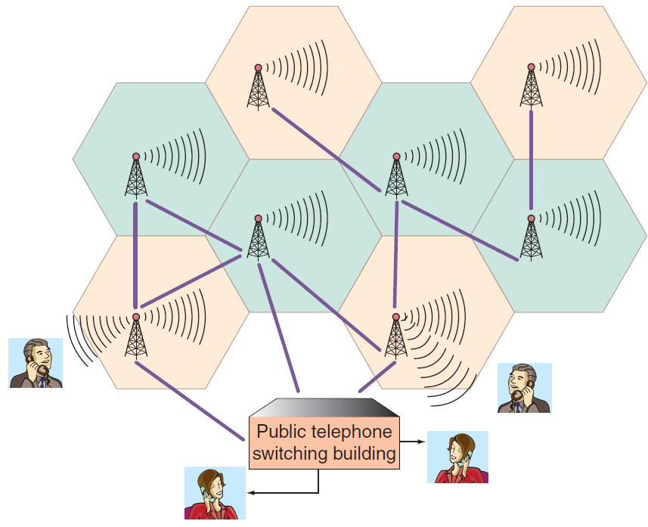
Smart Phone & GPS system
Cellular Radio: Cellular telephones (cell phones) provide two-way radio communications over a cellular network of base stations with seamless handoffs.
Notes:
Cellular Radio: Cellular telephones (cell phones) provide two-way radio communications over a cellular network of base stations with seamless handoffs.

Slide 50
Generations of Cellular Technology Evolution
Generations of Cellular Technology Evolution:
First generation (1G): cellular networks used analog signals and had low bandwidth (capacity).
Second generation (2G): uses digital signals primarily for voice communication; it provides data communication up to 10 Kbps.
2.5G: uses digital signals and provides voice and data communication up to 144 Kbps.
Third generation (3G): uses digital signals and can transmit voice and data up to 384 Kbps when the device is moving at a walking pace, 128 Kbps when it is moving in a car, and up to 2 Mbps when it is in a fixed location. It supports video, Web browsing, and instant messaging.
Fourth generation (4G): is not one defined technology or standard. The International Telecommunications Union (ITU) has specified speed requirements for 4G: 100 Mbps (million bits per second) for high-mobility communications such as cars and trains, and 1 Gbps (billion bits per second) for low-mobility communications such as pedestrians. A 4G system is expected to provide a secure all-IP-based mobile broadband system to all types of mobile devices.
Fifth Generation (5G): expected to be deployed by 2020, 5G networks are predicted to be faster and more intelligent than previous generations of cellular networks. With 5G, wearable computers (e.g., Fitbit), smartphones, tablets, and other devices with sensors that are location- and context-aware will work together with apps and services that you use.
Notes:
Generations of Cellular Technology Evolution:
First generation (1G): cellular networks used analog signals and had low bandwidth (capacity).
Second generation (2G): uses digital signals primarily for voice communication; it provides data communication up to 10 Kbps.
2.5G: uses digital signals and provides voice and data communication up to 144 Kbps.
Third generation (3G): uses digital signals and can transmit voice and data up to 384 Kbps when the device is moving at a walking pace, 128 Kbps when it is moving in a car, and up to 2 Mbps when it is in a fixed location. It supports video, Web browsing, and instant messaging.
Fourth generation (4G): is not one defined technology or standard. The International Telecommunications Union (ITU) has specified speed requirements for 4G: 100 Mbps (million bits per second) for high-mobility communications such as cars and trains, and 1 Gbps (billion bits per second) for low-mobility communications such as pedestrians. A 4G system is expected to provide a secure all-IP-based mobile broadband system to all types of mobile devices.
Fifth Generation (5G): expected to be deployed by 2020, 5G networks are predicted to be faster and more intelligent than previous generations of cellular networks. With 5G, wearable computers (e.g., Fitbit), smartphones, tablets, and other devices with sensors that are location- and context-aware will work together with apps and services that you use.

Slide 51
Wireless Broadband or WiMAX
Worldwide Interoperability for Microwave Access (WiMAX)
WiMAX = IEEE Standard 802.16
To provide point-to-multipoint wireless access to Internet and other networks
To provide high data rates over 10-40km
Data transfer rate of up to 75 Mbps
A secure system offering voice and video
Notes:
Wireless Broadband or WiMAX: Worldwide Interoperability for Microwave Access (WiMAX) is the name for IEEE Standard 802.16 which has a wireless access range of up to 31 miles and a data transfer rate of up to 75 Mbps. It is a secure system, and it offers features such as voice and video.

Slide 52
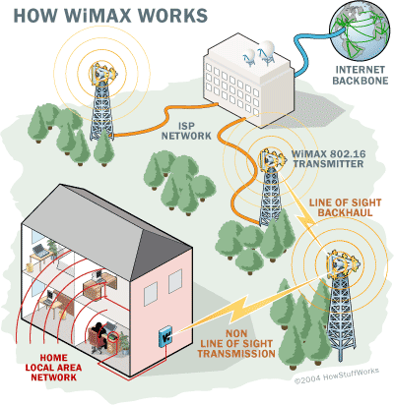
Purpose of WiMAX
To provide point-to-multipoint wireless access to Internet and other networks
To provide high data rates over 10-40km

